Slide 1

COMPATIBILITY CALCULATOR
-Perfect Signs-
Aastha Jha, Devina Sen, Varsha Sundar

Slide 2
AGENDA
01
02
03
PROBLEM
SOLUTION
TARGET USERS
04
05
06
DEMO
APPROACH
NEXT STEPS

Slide 3


VISION
GOAL
By 2040, about 70% of couples will have met online. Studies show millennials spend on average 20 hours/week on dating apps
The dating industry is estimated to be worth $3 billion but currently only at a 44% success rate.
Our goal is to create a prediction tool that can ultimately combat dating app “overuse” and elevate matchmaking experiences with a more precise algorithm.
Notes:
https://www.marketwatch.com/story/this-is-why-loneliness-and-dating-apps-are-such-a-bad-match-2019-08-01
https://www.psychologytoday.com/us/blog/close-encounters/201908/can-using-online-dating-apps-be-addictive

Slide 4

Can we predict a user’s preferences in a partner for overall relationship compatibility and happiness?

Slide 5
SOLUTION
COLLECTING
LEARNING
PREDICTING
Responses from individuals and their partners / ex-partners on their background, compatibility, happiness, and personality traits in the relationship.
Understand which features correlate to successful and which correlate to unsuccessful relationships.
Based on certain traits an individual has, can we predict what their ideal significant other should be?

Slide 6
OUR TARGET MARKET
MATCHMAKING PLATFORMS
2. END USER

Slide 7





MATCHMAKING PLATFORMS
Dating Apps
Matrimonial Sites
Platforms
Users often switch between multiple apps
Creating algorithm that understands and updates user preferences
Pain Points
Goals
To better satisfy users
Improve algorithm in filtering profiles
Become a preferred choice in dating industry

Slide 8

END USERS
Young adults
Users
Spending excess time on dating apps leading to addiction & frustration
Unsure of partner type
Pain Points
Goals
Interested in exploring romance and longevity of their relationships

Slide 9
DEMO
http://perfectsigns.herokuapp.com/

Slide 10
APPROACH
DATA COLLECTION
LOGISTIC REGRESSION
UI
EDA
Created a logistic regression model. Used a decision tree to help create response generator for given input.
Sent Google survey to capture current/former couple information
Created a Dash app where users can take survey and find out their ideal match’s zodiac & other traits
Explored correlations &. selected respondent features as X variable & partner traits as Y.

Slide 11
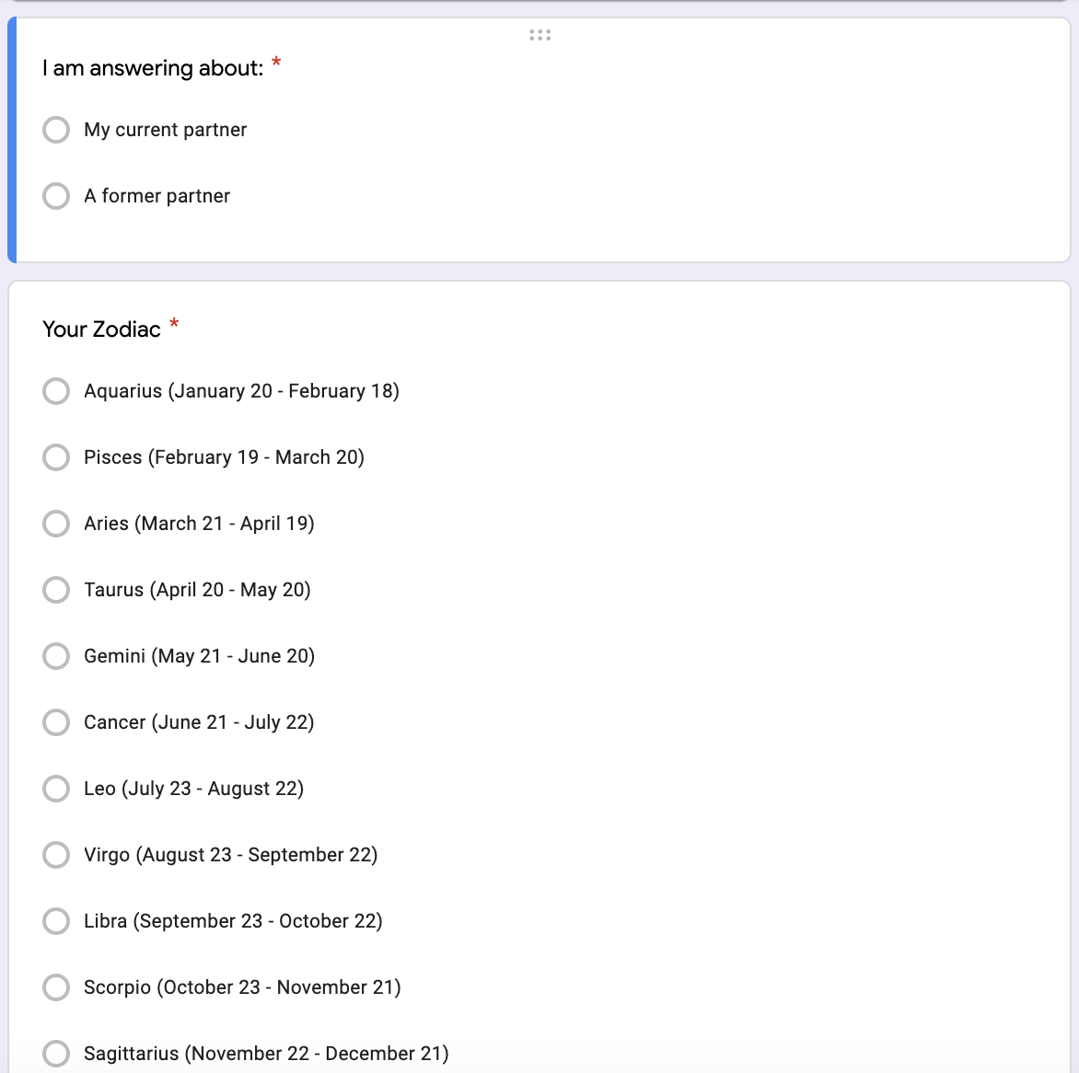
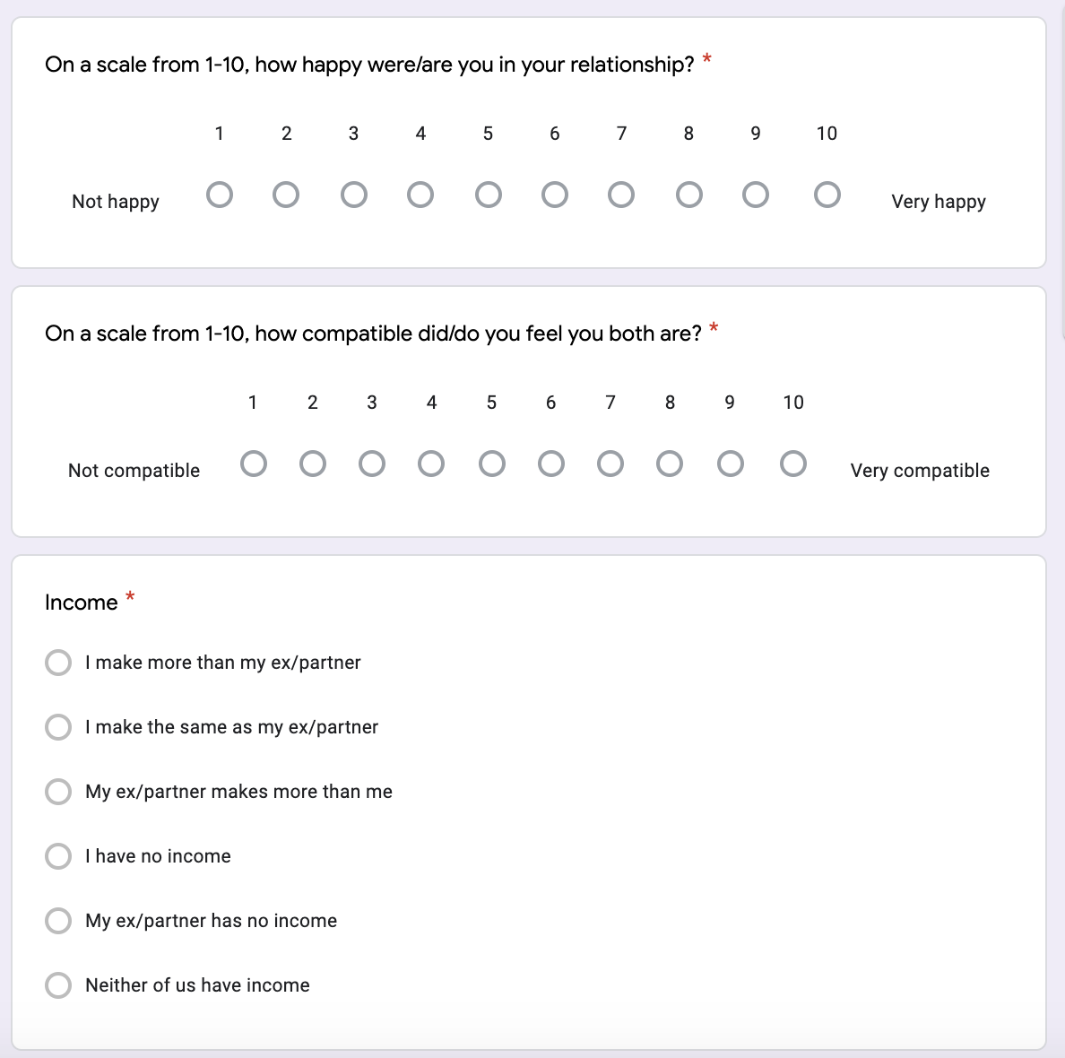
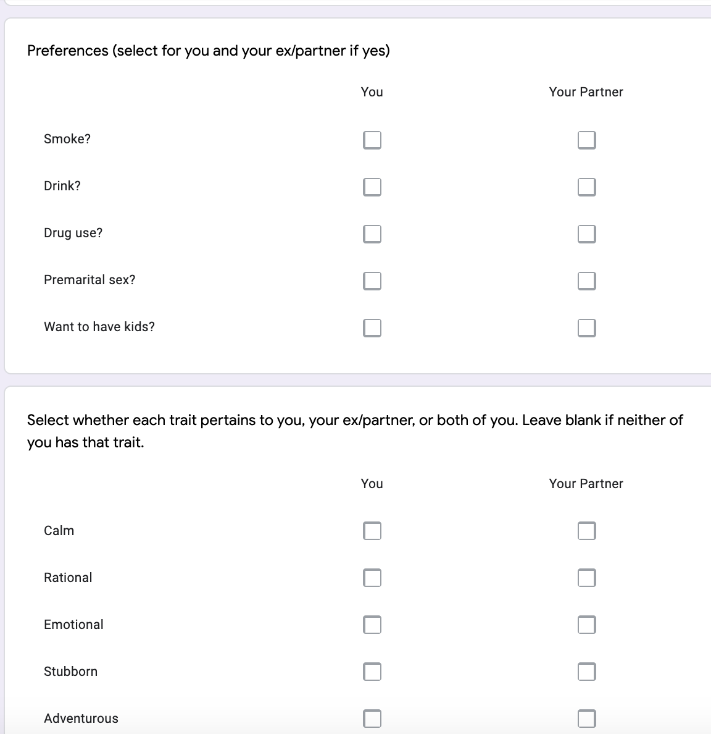
DATA COLLECTION
Google survey
Notes:
https://forms.gle/eDpahNAHxfY4nc43A

Slide 12
FEATURE ENGINEERING
Background
Traits
* Gender
* Same Ethnicity
* Same Religion
* Same Political
* Zodiac
* Education
* Age
* Calm
* Rational
* Emotional
* Stubborn
* Adventurous
* Creative
* Analytical
* Introvert
* Extrovert
* Going Out
* Staying In
Views
* Smoke
* Drink
* Drug
* Premarital Sex
* Kids

Slide 13
ALGORITHM
Used features pertaining only to the respondent and not their partner
2 Main Aspects to Model
Decision Tree Classifier to predict most compatible horoscope
Logistic Classification Model to determine which features most commonly appeared in similar relationships
Our models accuracy scores range from 0.8 to 0.95 depending upon the model.

Slide 14
LEARNINGS
UNSUCCESSFUL IDEAS
PIVOTS
NEW LEARNINGS
- Forcing an online couples dataset to fit our project. While it had features of interest, it did not align with project goals.
- Linear regression yielded a negative training accuracy
-Data Collection: Collecting our own data using Google form
-Solution: Switched to providing an ideal match report instead of a compatibility score.
-Model: Logistic Regression
- Weekly check-ins and consistent OH with Ishaan helped level-set objectives
-Balance between teamwork & individual
- Experimented with new scikit-learn tools & packages
-UI (Dash, Heroku app)

Slide 15
NEXT STEPS
1
2
3
4
Improve algorithm by obtaining more data
Send a survey to get user feedback and iterate on UI
Provide numeric scores for partner features and/or a scale of top compatible zodiacs
Understand integration with dating apps

Slide 16
THANK YOU

Slide 17
GitHub Repo
https://github.com/devinasen/perfectsigns.git

